Slide 1



Receive and place incoming telephone calls
Notes:
Discuss with trainees: How does the way you would speak to a customer on the telephone differ to the way you would speak to your friends or family? How many of you have ever worked in a job where you need to speak to customers on the telephone? What hints can you share with the rest of the class?

Slide 2
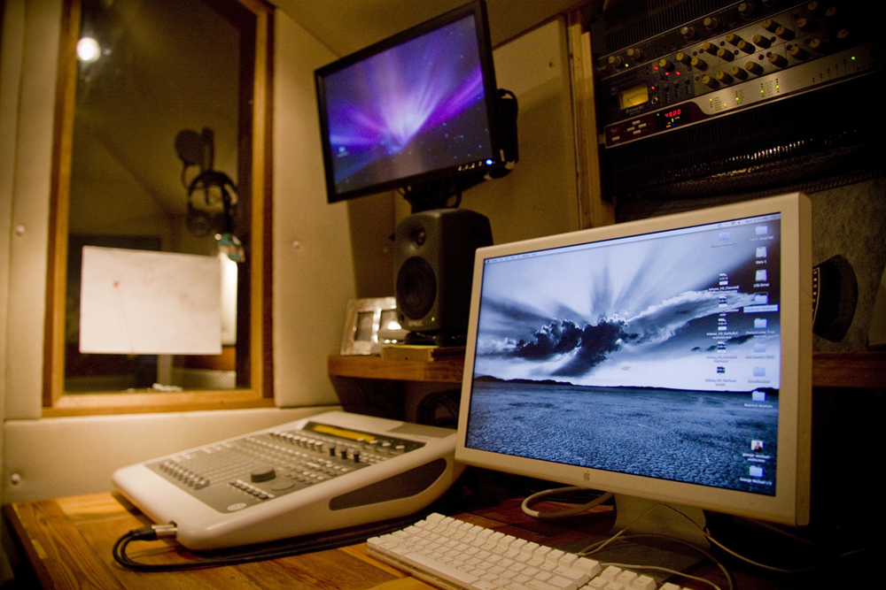
1. Identify elements and facilities of the host enterprise telephone system
Notes:
Class discussion: How many of you have a mobile phone? Make a list of the features available on a mobile phone e.g. camera, speaker phone, call forwarding etc. Which mobile phone features would also be available on a hotel phone system and how could they be used to improve the hotel’s performance and customer service e.g. message recording. Is there a place for mobile phones in a hotel – how could they be used to improve efficiency?

Slide 3

Identify the types of incoming calls that may be received and their importance to the business
Types of incoming calls include:
Enquiries
Calls from people for guests
Complaints
Messages
Contact with suppliers
Notes:
Since the 1890s telephones have enabled instant contact with hotels for bookings and requests.
The telephone plays an important role in communication with a hotel and within a hotel or resort.
Incoming calls by landline and contact via mobile or cell phone, including smart phones with internet linkage, make up a high percentage of guest contact with a hotel or resort.
The primary role of a receptionist or telephonist in a hotel or resort is to answer all incoming calls.
Incoming calls could be from external locations or in-house guests needing assistance or asking questions or staff contacting departments.
What are the types of incoming calls?
Class buzz session.
Looking at a hotel and its location list as many examples of incoming calls as the class can think of e.g. suppliers, contact for orders, new product, questions about orders that have been placed by the hotel etc. customer feedback etc.
Complaints made may relate to service (too slow, not respectful), about rooms, bed comfort, bathroom cleanliness, access to pool, gym, activities etc.

Slide 4
Aspects of incoming calls
Incoming calls
Internal and
External
Customers
Handling complaints
Be:
Helpful
Positive
Informed
Tactful
Polite
!!!@@@ ***!!

Slide 5




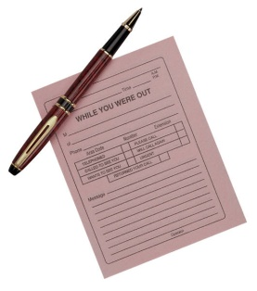
Aspects of incoming calls
Selling services and products
Provide information
Taking messages
Notes:
Role play: Trainees work in pairs to practice the roles of customers and reception staff making and receiving calls. If trainees are not confident to do this immediately they can spend some time writing up a dialogue that they can then perform with each other and then perhaps for the whole class group. When performing the role with each other trainees can sit back to back on chairs and pretend to be on the phone. Otherwise they can make real calls with their mobile phones and put it on speaker phone if the demonstration is being done for the whole class.
Trainees need to act their roles carefully – the Customer needs to complain strongly or at least be clear about what they want and the hotel reception staff member needs to display the qualities of helpfulness, being positive, informed, tactful and polite.

Slide 6
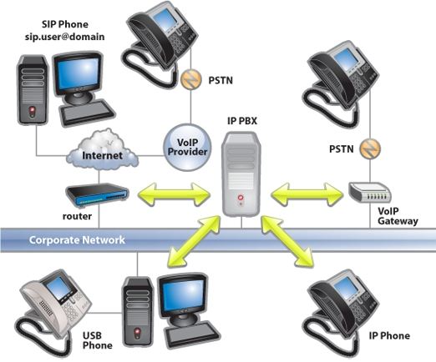
Identify the components of the telephone system
Components of a Telephone system:
Landline versus Wireless
Paging System
Switchboard
Handsets and head sets
VoIP telephones
Notes:
A Landline telephone system is connected by solid wires or fibre optic cable, tangible and visible, from one location to another.
Mobile or cellular phones make and receive calls using radio link or wireless connection.
A paging system offers discrete and immediate communication for staff.
Paging systems and mobile phones allow staff to work in operational areas and still be able to respond quickly to requests.
A switchboard is a piece of equipment that enables a hotel or resort to connect all the telephone lines and extensions used.
The handset is the part of the telephone which the user holds to their ear. Handsets are often referred to as receivers.
Headsets fit over the head and enable hands free action which permits the operator to take notes or operate a computer while taking a telephone call.
VoIP telephones use the internet to link and are rapidly increasing in usage, overtaking the traditional telephone network. The VoIP system enables notification of calls via email or text.

Slide 7
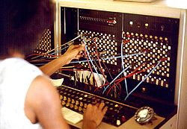
Describe the functions and features available in the telephone system
Features and functions of the system may include:
The facility to place calls on hold or transfer calls
To record messages
Text transmission
(Continued)
Notes:
The telephone system has a number of features and functions such as:
the facility to place calls on hold or transfer calls
to record messages electronically or use voicemail
message or text transmission
How would these features be used in practice to improve communication?

Slide 8
Describe the functions and features available in the telephone system
Notification of missed calls
Call diversion
Caller identification
Notes:
The telephone system has a number of features and functions such as:
notification of missed calls or busy numbers not answered
call diversion and call blocking
caller identification
How would these features be used in practice to improve communication?

Slide 9

Class activity
Work in groups and:
Compare the telephone needs of a small hotel against a large hotel
List the features and components of the system most suited to each
Compare the standard greetings of a small hotel against a large hotel.
Notes:
Switchboard
Multiple extensions
Multiple lines
Computer interface
Monitor all incoming and outgoing calls
Timed calls
Fax & Internet access (in-room)
Email access (in-room)
Single telephone line
Fax access (Venue use only. May be separate number to telephone)
Telephone
Email access

Slide 10
2. Demonstrate appropriate telephone communication skills
Notes:
Explain to trainees that this section will discuss issues such as privacy concerns, dealing with threatening calls, security issues and appropriate telephone greetings.

Slide 11

Interpret the enterprise policies and procedures for telephone use in regard to incoming calls
Policies and procedures for telephone use can relate to:
Privacy
Threatening calls
Standard greetings
Security and confidentiality
Training
Notes:
The use of the telephone is one of the most vital business tools in use today.
More business is won or lost on the phone than by any other means.
Every staff member should undergo formal training in correct telephone procedures.
Privacy
A hotel or resort will have a policy to protect the privacy and confidentiality of its guests. Guests’ messages and phone records are protected against fraudulent actions.
Threatening calls
Response to threatening or suspicious calls requires the receiver to remain calm, the call should be taken seriously and the receiver should not hang up.
Greetings
Standard greetings are established to maintain image or service quality.
Staff should answer calls courteously and identify the time of day, and pronounce words clearly, slowly, and with adequate volume.
Security
Many hotels or resorts have created a "Privacy policy statement" relating to how and what they do with the personal information collected from guests.
Staff can often be tempted to pass on information about celebrities or prominent people to newspapers and magazines when these guests are staying at their hotel.
Training
Telephone system training is required to maintain the standards of the hotel or resort.
All systems require upgrading and even replacing and this will mean upgrade training for the staff.

Slide 12

Class activity
Create a list of rules for handling celebrity phone calls
Work in groups and discuss why privacy and confidentiality are protected
Write up your results to compare them with other groups
Notes:
Class discussion: If any of the class has worked or is currently working in a hotel they should tell the rest of the class some of the different ways celebrities are treated compared to ‘normal’ guests. What things are most important to celebrities? – for example, privacy, security. The class should work in small groups and, once they have composed their lists, share them with the rest of the class.

Slide 13

Explain the importance of first impressions in relation to telephone answering and the reputation of the business
The first impression you give is important:
Your voice projects the establishment
Tone and pitch must convey type and style of establishment
Tone and language influence first impression and reflect on establishment reputation
Notes:
The voice that answers the telephone projects the image of the establishment and the tone and pitch convey the type and style of establishment. Many establishments nominate a 'script' to follow so all staff who use the telephone system offer the same standard greeting and project the image of the establishment. The first impression a guest is given is lasting, and will be difficult to alter if it’s an unfavourable one. The tone and language of the greeting will also influence the all important first impression and reflect on the establishments reputation.
In pairs trainees should write what they think would be a good standard greeting for a 4 or 5 star hotel. Try reading it out loud using appropriate tone and pitch.

Slide 14

Explain the importance of first impressions in relation to telephone answering and the reputation of the business
Class activity
Write a standard greeting and present it to your class
Is it giving a good first impression?
Does it reflect an image?
Notes:
In pairs trainees should write what they think would be a good standard greeting for a 4 or 5 star hotel. Try reading it out loud using appropriate tone and pitch.

Slide 15
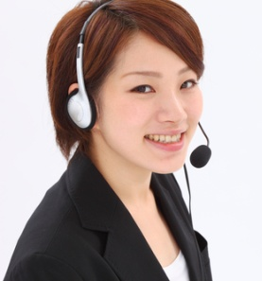

Differentiate between face-to-face and over-the-phone communications
Face to face | Telephone
Body language | Impact of voice
Visual actions matching non-verbal | Pitch and tone
Visual aides used | Volume
Written communication | Questioning
 | Listening
Notes:
Over the phone staff need to communicate the major part of any information with voice only. Therefore how and what is said is suddenly that much more important.
There is a need to think about voice tone, pace and volume, to project a professional image.
On top of that things that would normally be shown visually, like friendliness or enthusiasm, also need to be communicated through the voice.
During face to face conversation, people can not only hear responses from others, but also see their expressions and body language and interpret how they are feeling. Non-verbal responses can indicate that staff need to supply more information to clarify issues.
Class activity
Students should listen to each other repeating the standard greeting and comment on the sound of the voice.

Slide 16

Use the appropriate telephone communication skills
All calls should be responded to:
In a professional manner
Answered promptly
Answered politely
(Continued)
Notes:
Telephone communication requires certain skills including the appropriate attitude, energy level, voice tone and volume.
The ability to speak clearly and distinctly with no jargon and an ability to listen attentively is also required.

Slide 17
Use the appropriate telephone communication skills
Assistance offered in a friendly manner
Questions asked politely to establish the purpose of the call
Notes:
Telephone communication requires certain skills including the appropriate attitude, energy level, voice tone and volume.
The ability to speak clearly and distinctly with no jargon and an ability to listen attentively is also required.

Slide 18
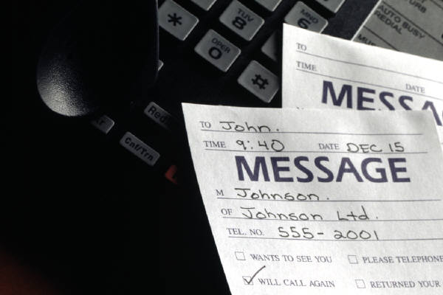
Use appropriate telephone techniques.
Telephone techniques must display professionalism and provide excellent service:
Clarify caller requirements
Repeat names, dates and times
Check spelling
Notes:
Efficient and effective use of the telephone requires skill in use and knowledge of the telephone system and the procedures and policies.
All staff that use the telephone need to use appropriate telephone techniques.
Well developed telephone techniques will display an impression of professionalism and provide excellent service.
Clarify caller requirements
Use your questioning and listening skills to clarify what the caller has requested.
Repeat names, dates and times
Whenever guests give you details like their name make sure you spell it correctly. If you are not sure about the spelling then ask the guest to spell it. Read the letters back to the guest for clarification. Using the phonetic alphabet will help with an misunderstanding of letters being heard over the phone.

Slide 19

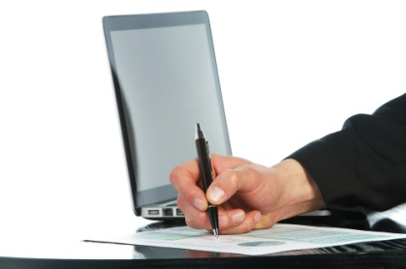
Class activity
Check the pronunciation of the following names
Use the Phonetic alphabet to clarify:
Tony Tan Keng Yam
Liu Shaoqi
Zakir Hussain
Sao Shwe Thaik
Surawit Khonsomboon
Salvador Laurel
Lim Goh Tong
Halim Saad
Notes:
Conversation Activity
The trainee/students do the conversation in pairs and the student who will be the operator needs to rewrite the guest’s name.

Slide 20

Describe acceptable telephone etiquette
Acceptable telephone technique includes:
Answer the call within three rings
Speak clearly and slowly
Be courteous, civil and respectful
Use appropriate opening phrase
(Continued)
Notes:
Telephone Etiquette
Answer the call within three rings
Always speak clearly and slowly with courtesy, civility and respect
Avoid extreme volumes
Avoid jargon or hotel terminology
Speak with a smile on your face
Use an appropriate opening phrase and listen to the response. Reduction of background noise can make hearing more efficient.

Slide 21
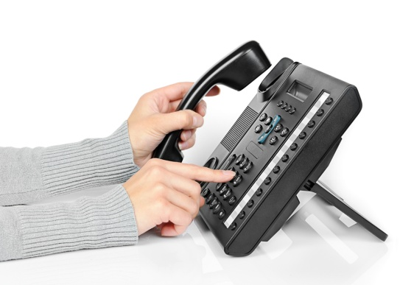
Describe acceptable telephone etiquette
Listen to caller
Reduce background noise
If there is caller ID on the telephone system, use guest's name
Repeat details back to the guest
(Continued)
Notes:
Trainer continues to discuss telephone etiquette with trainees inviting comments and stories from personal experience.

Slide 22
Describe acceptable telephone etiquette
Verify spelling where required
Transfer calls promptly
Ask before putting guest on hold.
Never eat, drink or smoke while on the phone
Use suitable closing phrase – thank caller for calling
Notes:
Trainer continues to discuss telephone etiquette with trainees inviting comments and stories from personal experience.

Slide 23
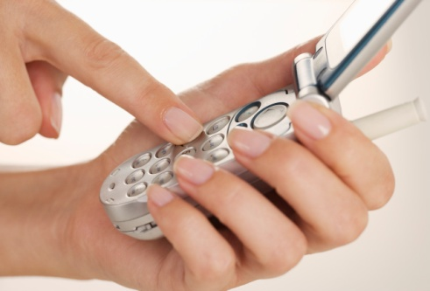
Class activity
Role play to demonstrate telephone techniques
Ring a friend and take a message
Leave a message for a guest at the hotel who is:
Your boss
A couple on their anniversary
A friend in town to visit
A business associate here for a meeting
Notes:
Role play can happen in pairs and later be shared with a larger group.

Slide 24
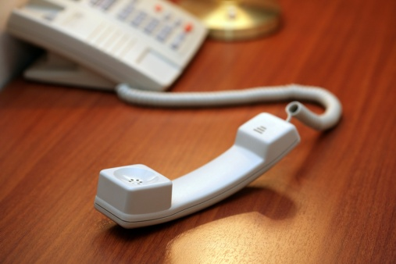
Identify common caller complaints about telephoning a business
Common caller complaints:
Telephone rings too long before being answered
Being placed on hold for too long
Inability to get through – line is always busy
Receptionist is defensive or abusive when guest complains
(continued)
Notes:
Common caller complaints.
The telephone rings too long before being answered. If the guest is waiting to have a call answered they can become frustrated and angry. Some telephones have capacity to record how long a phone rings before it's attended to. A guest speaking face to face with staff will find it distracting if a phone rings and rings without being answered.
Being placed on hold for too long, Guests should always be asked if they want to be on hold or for a message to be taken. If a guest is on hold then staff should check back frequently.
Inability to get through, such as the line or number is always busy. Again if the guest is waiting to have a call answered they can become frustrated and angry. Some venues have electronic messaging or voicemail to avoid this.
If a guest has complained and the receptionist becomes defensive or abusive. The guest or caller may ask for the receptionist’s name so the guest can take their complaint further.

Slide 25
Identify common caller complaints about telephoning a business
Reception fails to determine where call should be directed
Failure to listen properly to requests and questions
System failure or staff incompetence with the system
Lack of professionalism
Lack of product/venue knowledge.
Notes:
Difficulty can arise if reception or the switchboard fails to determine where the call should be directed. This could mean there has been a failure to update contact information.
One of the important points of communication is to listen. Failure to listen to guests’ requests and questions can lead to misunderstanding and disgruntled guests. Reception should repeat the caller request to clarify it (if necessary) and reconfirm it to the respective department when the call is transferred.
All systems can experience system failure. Often the failure is outside the control of management. Occasionally incompetence with the system; for example, the caller is disconnected when being transferred is the cause of guest dissatisfaction.
Lack of professionalism, including failure to place call on hold before talking to colleagues, giving an inappropriate greeting, lack of knowledge about the establishment and its staff and the use of an improper tone of voice by receptionist are all situations which can be cause for caller complaint.

Slide 26

Class activity
Role play the following:
Guest has rung to complain about a dirty bathroom
Guest has rung to complain about a rude housemaid
Guest has rung to say they will arrive late and been on hold for 20 minutes
(Continued)
Notes:
This activity should be done in pairs.

Slide 27

Class activity
Guest has rung to ask help for reserving a taxi
Guest has rung to ask help for reserving a flight ticket.
Notes:
This activity should be done in pairs.

Slide 28
3. Receive incoming calls
Notes:
Trainer to discuss content of this Element with trainees.

Slide 29
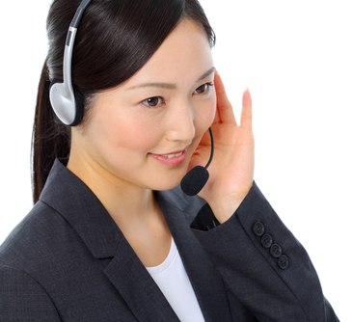
Prepare to receive incoming calls
Start with a smile on your face
Have paper and pen ready to record information
Have a comprehensive list of in-house extensions
Have a list of frequently called numbers
Notes:
Reception or telephone staff should be doing all the necessary things in order to efficiently and confidently receive and make telephone calls:
Smile – this will reflect in your voice when you are talking, improving the tone and pitch
Paper and pen ready to record information
A list of in-house extensions by the phone, this may be electronic or written, or may be the in-house guest report as produced by the night audit
Have a list of frequently called numbers such as taxis, theatres, restaurants, tourist tour operators or other external services. There should also be a list of emergency numbers.

Slide 30

Prepare to receive incoming calls
Develop good knowledge of all departments and their areas of responsibility
Sit upright and adjust the chair and equipment
Prioritize calls according to property guidelines
Activate call waiting and other automatic systems
Ensure no outside distractions.
Notes:
Reception or telephone staff should be doing all the necessary things in order to efficiently and confidently receive and make telephone calls:
Smile – this will reflect in your voice when you are talking, improving the tone and pitch.
Paper and pen ready to record information.
A list of in-house extensions by the phone, this may be electronic or written, or may be the in-house guest report as produced by the night audit.
Have a list of frequently called numbers such as taxis, theatres, restaurants, tourist tour operators or other external services. There should also be a list of emergency numbers.
Know where and how to direct each enquiry. A good knowledge of all departments and their areas of responsibility will ensure prompt response to all enquiries.
Sit upright and adjust the chair and equipment to best suit the person's stature.
Knowledge of all operator connected calls, and directory assistance procedures.
Prioritize calls according to property guidelines
Activate call waiting and other automatic systems
message waiting system
the wakeup call system
activate the voice mail system.
When operating the telephone system staff must ensure there are no outside distractions.

Slide 31
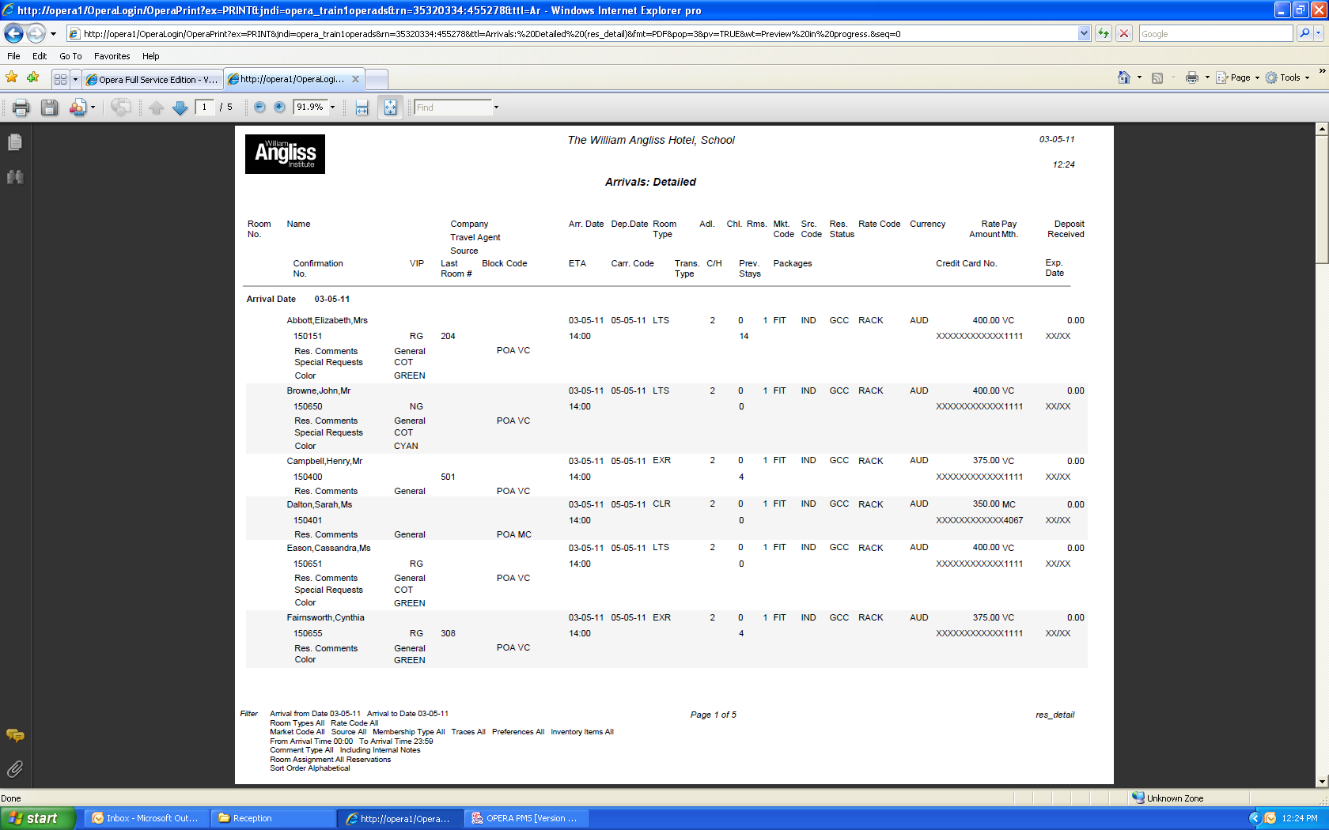
Example of arrival list
Notes:
Discuss the above example of an arrivals list – Opera Software

Slide 32

Answer calls promptly in accordance with house standards
Use house standard greetings
Identify self and the hotel or resort
Greet the caller and offer assistance or question them to ascertain the purpose of the incoming call
Focus on the call, especially listening carefully to the caller’s voice
Notes:
All staff who use the telephone to accept incoming calls should maintain the same standard etiquette and skills.
When answering call staff should ensure all calls;
Are answered before house ring limit is reached, usually by the third ring.
Use an enterprise standard greeting is a statement of who you are and what your establishment’s values are.
Identifying self or position and the hotel or resort, greet the caller and offer assistance or question them to ascertain the purpose of the incoming call.
Focusing and concentrating on the call, especially listening carefully to the callers voice.

Slide 33

Answer calls promptly in accordance with house standards
Take notes and details of any request
Identify whether caller is calling long-distance or international
Identify if caller is a designated VIP caller, return guest or corporate guest whose company has a contract with the venue.
Notes:
All staff who use the telephone to accept incoming calls should maintain the same standard etiquette and skills.
When answering call staff should ensure all calls;
Are answered before house ring limit is reached, usually by the third ring.
Use an enterprise standard greeting is a statement of who you are and what your establishment’s values are.
Identifying self or position and the hotel or resort, greet the caller and offer assistance or question them to ascertain the purpose of the incoming call.
Focusing and concentrating on the call, especially listening carefully to the callers voice.
Taking notes and details of any request.
Identifying whether caller is calling long-distance or internationally
Identifying if caller is a designated VIP caller, a return guest or a corporate guest whose company has a contract with the hotel or resort.

Slide 34
Identify long-distance or international calls
Calls from other countries will need to be co-ordinated with time zone information
The list of country codes should be placed in an easy place and accessible to all of the staff
Charges for international calls vary according to time zone and distance
Notes:
Calls from other countries will need to be co-ordinated with time zone information.
Charges for international calls vary according to time zone and distance.

Slide 35
Identify long-distance or international calls
When answering incoming calls from international locations, staff may need to have language skills or access to interpreters
International calls may be connected by a telephone operator or satellite connection
Notes:
When answering incoming calls from international locations, you need language skills or access to interpreters or software that would perform translation.
International connected by a telephone operator or satellite connection; fees will vary according to the country and duration of the call. A satellite call is more expensive than wireless connection.

Slide 36

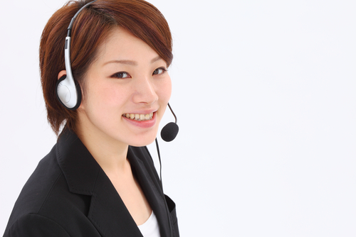

Establish the purpose of incoming calls
Determine the purpose of the call
Follow up an initial greeting with clarifying questions
Use the hotel’s database to find information
Use selling and promotional techniques
Notes:
When receiving incoming calls it’s important to determine the purpose of the call so it can directed to the appropriate staff or department In a large hotel or resort.
The telephone operator may answer calls on behalf of several different departments and then transmit the information to appropriate staff by pager or text.

Slide 37
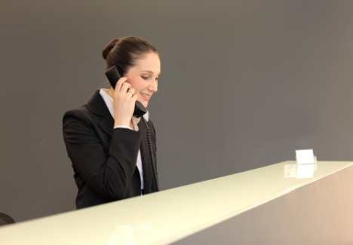
Respond to caller requests, where appropriate
Give the guest your full attention
Show genuine interest in their questions
If you know the answer:
Tell the guest and ask if there is anything else you can help them with
Finish the conversation with a pleasant greeting
(continued)
Notes:
Respond to guest requests.
React promptly, give the guest your full attention and show genuine interest in their questions.
If you know the answer:
Tell the guest and ask if there is anything else you can help them with.
Finish the conversation with a pleasant greeting, e.g. ‘I hope you enjoy your stay’.

Slide 38

Respond to caller requests, where appropriate
If you don’t know the answer:
Never say ‘No’, apologise where an immediate, correct response cannot be given
Offer to find out and get back to the guest with the answer
(Continued)
Notes:
If you don’t know the answer:
Never make it up or say, ‘ I don’t know’ or ‘That’s not my department’. You should apologise where an immediate, correct response cannot be given.
Offer to find out and get back to the guest with the answer. This may involve putting the guest on hold or taking details and returning the call.

Slide 39
Respond to caller requests, where appropriate
The guest should not be kept waiting while you find the answer
Offer to deliver the information or call back
Make sure you follow up and get back to the guest quickly
Notes:
Do not keep the guest waiting while you try to find the answer. Offer to deliver the information or call back or transfer the call to a guest services attendant or another department who can best answer the question.
Make sure you follow up and get back to the guest quickly.

Slide 40
Take messages from callers
To take messages accurately make sure that you record:
Who the message is for
Who left the message
Repeat the name back and check if it’s correct
(Continued)
Notes:
To take messages accurately make sure that you record:
Who the message is for asking for the full name and remembering that you might have 10 guests with the name Ng or Lee staying in the hotel
Who left the message; repeat the name back and make sure that you have the correct spelling. Record any details of Company and the caller’s city, which is required to estimate time for the return call to occur.
The number and any extension of the person leaving the message. Check and repeat this back to the caller so that you do not give your guest the wrong number.

Slide 41
Take messages from callers
Record the number of the person leaving the message
Take an accurate message
Confirm the importance and urgency and any action requested or promised
(Continued)
Notes:
The number and any extension of the person leaving the message. Check and repeat this back to the caller so that you do not give your guest the wrong number.
An accurate message should be taken; repeat the message back to confirm this with the caller. Confirm the importance and urgency and any action requested or promised.

Slide 42
Take messages from callers
Lastly record the date and time of the call, including the action and follow-up
Include the name of the person who recorded the message
Notes:
Lastly record the date and time of the call, including the action and follow-up .Also include the name of the person who recorded the message. If the message has been entered into an electronic system or PMS, then it will automatically be dated, time stamped and carry the ID of the staff member who entered the data.

Slide 43


Class activity
Use a message pad
Role play taking guests’ requests and messages
Work with a partner where one plays a guest and the other the telephone operator
Notes:
This helps the students become familiar with the art of message taking.

Slide 44
Relay messages and follow-up as necessary
Messages can be left under guests’ doors
A message notification can be activated
Text messages can be transmitted instantly
(Continued)
Notes:
All messages received and recorded need to be distributed to their recipients.
In regards to distribution of messages it is essential that it is timely and accurately distributed.

Slide 45
Relay messages and follow-up as necessary
Messages may be left in a pigeon-hole or message book. A guest may call to collect a message
Messages left for incoming guests may be delivered verbally or printed
A message may carry a facility to confirm delivery
Notes:
Porter duties usually include taking messages, packages or mail for in-house guests in liaison with reception staff, receiving and distributing guest mail, messages, emails and faxes.
A message may be left for an expected guest and notification can be attached electronically to the reservation information.

Slide 46
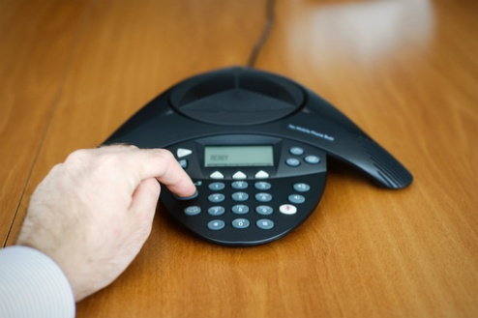
Facilitate conference calls
A conference call:
Is a call where more than one party can listen in
may be designed to allow the called party to participate during the call
May be set up so the called party only listens and cannot speak
Can be set up to view the other caller
Notes:
A conference call is a telephone call in which the calling party wishes to have more than one called party listen in to the audio portion of the call. The conference calls may be designed to allow the called party to participate during the call, or the call may be set up so that the called party merely listens into the call and cannot speak. It can also be set up to view the other caller. This is sometimes called Teleconference.

Slide 47
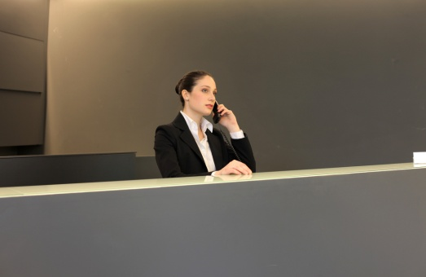
Deal with suspicious or threatening callers
It is important to remain calm:
Do not hang up
Get detailed information
Do not laugh or treat the threat lightly
Don’t be angry or upset
Confirm the call is genuine
Keep a record of the conversation
(continued)
Notes:
Whatever the threat or suspicious behaviour there are certain steps to follow.
It is important to remain calm. Do not hang up as this can enable the authorities to trace the call. By capturing as much detail as possible about the call, caller and nature of the threat, the caller should be treated with respect and not abused. Staff should not laugh or treat the threat lightly. It’s important not to be angry or upset as this could cause the caller to become agitated and hang up or escalate the situation. But it is also important to confirm the call is genuine and not a prank or joke. Despite the cause or reason a record should be kept of the conversation.

Slide 48

Deal with suspicious or threatening callers
For a bomb threat:
Get a much information as possible
Find out if possible who is making the threat
Try to find out why/how they will carry out their threat
Find out who specifically the threat is against
Is there any action to be taken?
(continued)
Notes:
If it’s a bomb threat then try to get as much information as possible, who the group or individuals are who are making the threat, why and how they will carry out their threats. There is a need to establish who specifically the threat is against and why or when it will occur. Is there any action the telephonist can take that will solve the problem or difficulty?

Slide 49

Deal with suspicious or threatening callers
Policies and procedures have to be followed
Initiate an evacuation or implement the Emergency Management Plan (EMP)
Notify relevant authorities
Take it seriously
Immediately contact a supervisor
Notes:
The venue’s policies and procedures have to be followed and management and other staff notified of the situation. It may be that staff need to initiate an evacuation or implement the Emergency Management Plan (EMP) and also notify relevant authorities. If there is a serious threat management will call departments and room numbers to facilitate the warning of people in accordance with the Emergency Management Plan.
All threats and suspicious behaviour should be taken seriously and immediately contact a supervisor as to what is occurring.

Slide 50
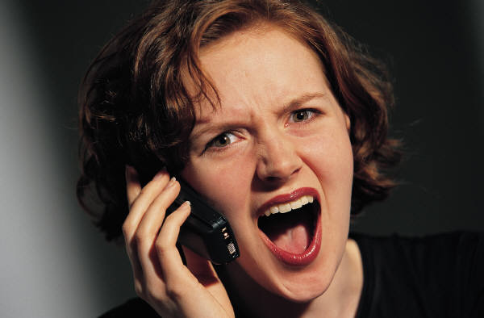
Manage difficult callers
Staff may find themselves having to answer the phone to a difficult caller. This will require tact, quick action or initiative:
Communication
Intoxication
Bad service
Rude callers
Notes:
When answering a difficult call the telephonist must first listen, then apologise.
Come to a conclusion explaining what action can be taken. Identify how the complaint will be dealt with and always follow up
By capturing as much detail as possible about the caller the caller should still be treated with respect. But it is also important to confirm the call is genuine and not a prank or hoax. Despite the cause or reason a record should be kept of the conversation. A difficult guest may simply be misunderstood, but for those who are angry or upset and not responding positively, remember to be tactful, keep cool, sympathise and try to give assistance but always call or notify management.

Slide 51
Prepare voicemail messages and background music
Voice mail is a computer-based system that will answer the caller and deliver voice information using an ordinary telephone
Most telephone systems have the ability to play an advertising message or music when a call is on hold
A guest on hold will wait if there is not silence at the end of the phone.
Notes:
Voice mail is a computer-based system that will answer the caller and deliver voice information about organisations, products and services, using an ordinary telephone. The term is also used more broadly to denote any system of conveying a stored voice messages.
Voicemail systems are designed to convey a caller's recorded audio message to a recipient.
Most telephone systems have the ability to play an advertising message or music when a call is placed on hold or before it answers.
Calls are placed on hold because there is a bank up of calls and the operator is busy.
Sometimes calls are put on hold manually. For instance, when you need to get some information for the guest you will inform them that they are going to be put on hold while you collect this information or speak to a supervisor. In this circumstance music or promotional messages can be used rather than the caller listening to nothing.

Slide 52

4. Redirect incoming calls
Notes:
Trainer to explain the idea and purpose of redirecting calls.

Slide 53
Transfer calls as appropriate
The procedure to transfer a call is:
Answer the incoming call according to venue procedures
Establish who the call is for
Thank the caller and ask the caller if you can transfer them
(Continued)
Notes:
Discuss why a call needs to be put on hold.
The procedure to transfer a call is:
Answer the incoming call according to establishment procedures
Establish who the call is for
Thank the caller and ask the caller if you can transfer them.

Slide 54
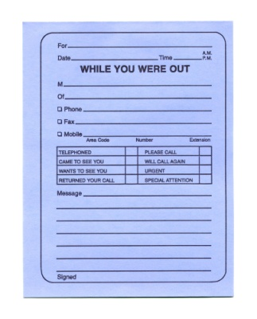
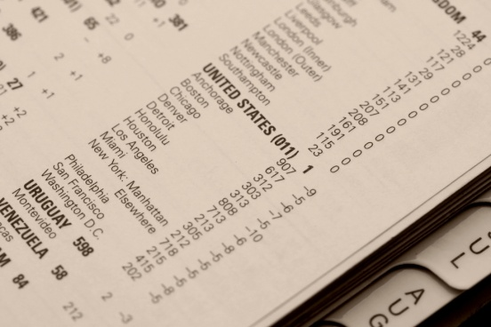
Transfer calls as appropriate
Explain where the call is being transferred to
If the caller does not want to be transferred you need to take a message.
Notes:
Explain where they are being transferred to.
If the caller doesn't want to be transferred you need to take a message.

Slide 55
Place calls on hold as appropriate.
Placing a call on hold:
Calls that need to be placed on hold usually have music or a recorded message to listen to
Before placing a call on hold, ask the caller’s permission
Return to the call within 30 seconds and provide an update on the status of their call.
Notes:
Discuss why a call needs to be put on hold.
The extension may be busy
There are several other calls to attend to at the same time.
If a caller indicates that they do not want to be put on hold and ask to have the call dealt with immediately, then you may have to take information and return the call at a later time.
Most telephone systems have the ability to play an advertising message or music when a call is placed on hold or before it answers.
Sometimes calls are put on hold manually. For instance, when you need to get some information for the guest you will inform them that they are going to be put on hold while you collect this information or speak to a supervisor. It is good practice to advise the guest what you are doing.
If a caller is on hold don’t forget to keep coming back to them to let them know what is happening. For instance, the line they are waiting for is still busy - do they want to call back or leave a message?.

